Slide 1
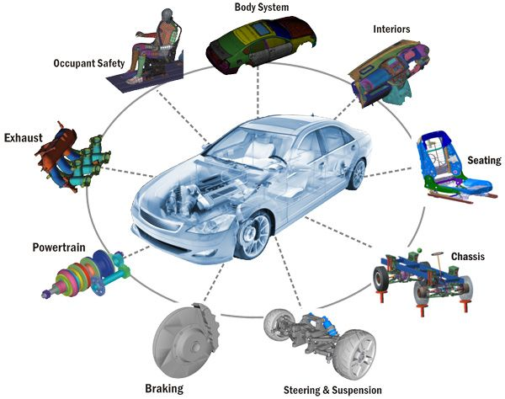
AUTOMOBILE SYSTEM

Slide 2
What Is Automobile System ?
Thousands of individual parts make up the modern automobile. ...
The major systems of an automobile are the
engine
fuel system
transmission
electrical system
cooling and lubrication system
and the chassis, which includes the suspension system
braking system
wheels and tires and the body.
These systems will be found in every form of motor vehicle and are designed to interact with and support each other.

Slide 3
What is Automobile And Their Types?
Automobile (car) – wheeled passenger vehicle that carries its own motor.
Most definitions of the term specify that automobiles are designed to run primarily on roads, to have seating for one to six people, typically have four wheels and be constructed principally for the transport of people rather than goods.

Slide 4
What is Vehicle Safety System?
Automotive safety is the study and practice of design, construction, equipment and regulation to minimize the occurrence and consequences of traffic collisions involving motor vehicles.
Road traffic safety more broadly includes roadway design.

Slide 5
What is the function of automobile?
Automobile, byname auto, also called motorcar or car, a usually four-wheeled vehicle designed primarily for passenger transportation and commonly propelled by an internal-combustion engine using a volatile fuel.

Slide 6
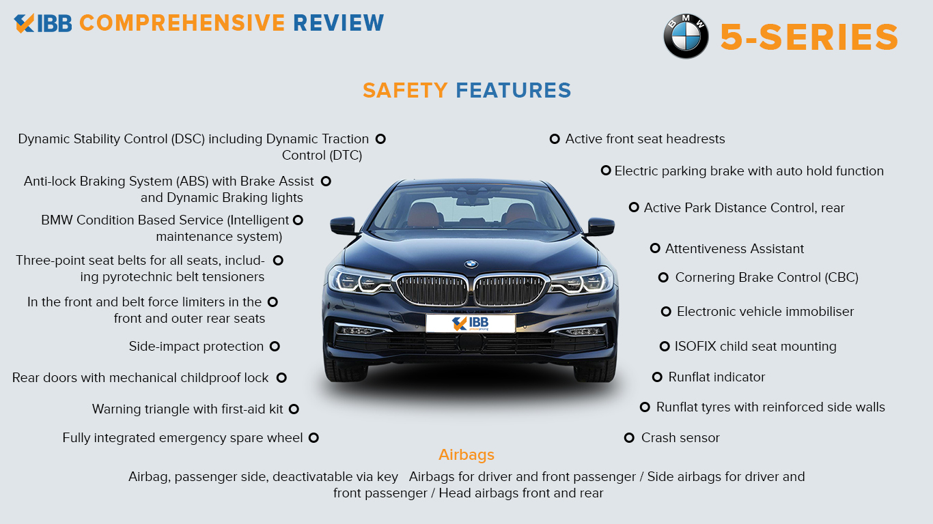

Slide 7
Some techinacal stuff
AI
MongoDB
TerraER
My_SQL
MathematicalProgramming

Slide 8


